Slide 1

Windows EventLog Persistence?
Windows can help us

Slide 2
#whoami
My name is Fabrício Gimenes (FgP)
I'm PurpleTeam Tech Manager at Telefônica Brasil.
I have 10 years of experience in Offensive Security.
I have some security certifications like OSCP,OSWE,CRTP,OSEP and I'm also Graduated in Cyber Defense.
LinkedIn
https://www.linkedin.com/in/fabricio-gimenes-93bb6828/
Twitter
@donotouchplease

Slide 3
Disclaimer
Nothing I say here represents my company, that is, all “shit” is my responsibility

Slide 4
The motivation
As I mentioned before, one of my favorite techniques is privilege escalation and persistence, so I decided to set up a LAB where I could find new techniques to become a NT/AUTHORITY and more. So, for my happiness good things happening!!!!
Look out for upcoming sleds ☺

Slide 5
Agenda
RedTeam Attack Simulation
PowerShell Constrained Language Mode
Custom Runspaces​ and Recon
Practical Privilege Escalation
What’s Privilege Escalation?
AlwaysInstallElevated “New Approach”
Practical Persistence
Windows Event Log

Slide 6
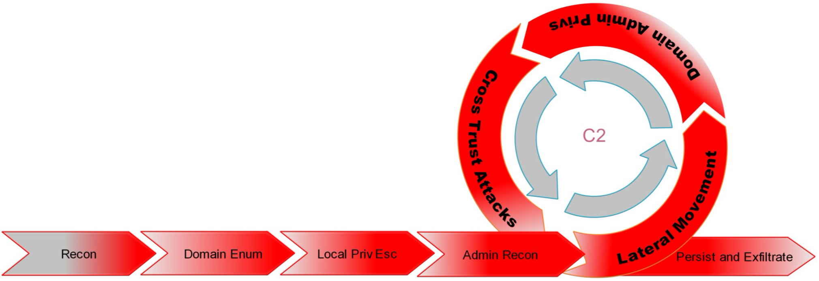
RedTeam Attack Simulation
CLM
Constrained Language
AlwaysElevatedInstaller
Windows EventLog
Notes:
Simulation of real-world attacks is possible only through astute observation of the nature of attacks and investigating the intentions of the adversary. We need to know the threat agent and its purposes (reputational loss, data destruction, etc.) to enable better protection in place. Detection initiatives driven with no knowledge of the nature of attacks and adversary’s intention will be a wild goose chase.

Slide 7

PowerShell Constrained Language Mode​

Slide 8
PowerShell Constrained Language Mode​
There are three types of language modes in PowerShell:
Full Language Mode: This mode allows scripts to use all the features of PowerShell.
Constrained Language Mode: This mode restricts access to certain APIs and commands to help prevent malicious code from running.
Restricted Language Mode: This is the most restrictive mode and only allows a limited set of commands to be used, making it useful for environments where strict security controls are necessary.
This property is stored in the environment variables as __PSLockdownPolicy. Environment variables are stored in the registry key and can be enforced via registry protections
https://devblogs.microsoft.com/powershell/powershell-constrained-language-mode/
Notes:
Constrained Language Mode is a security feature in PowerShell that limits the commands and features that can be used by a script. This mode is designed to prevent potentially malicious code from running on a system. When this mode is enabled, PowerShell restricts access to certain APIs and commands that can be used to run arbitrary code.

Slide 9
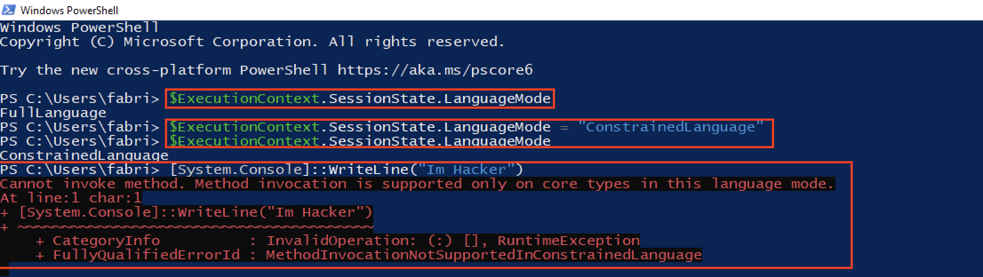
Enabling Constrained Language - For dummies
There are same ways to enable Constrained Language, enable this protection through poweshell session is not good way as we can see bellow.

Slide 10
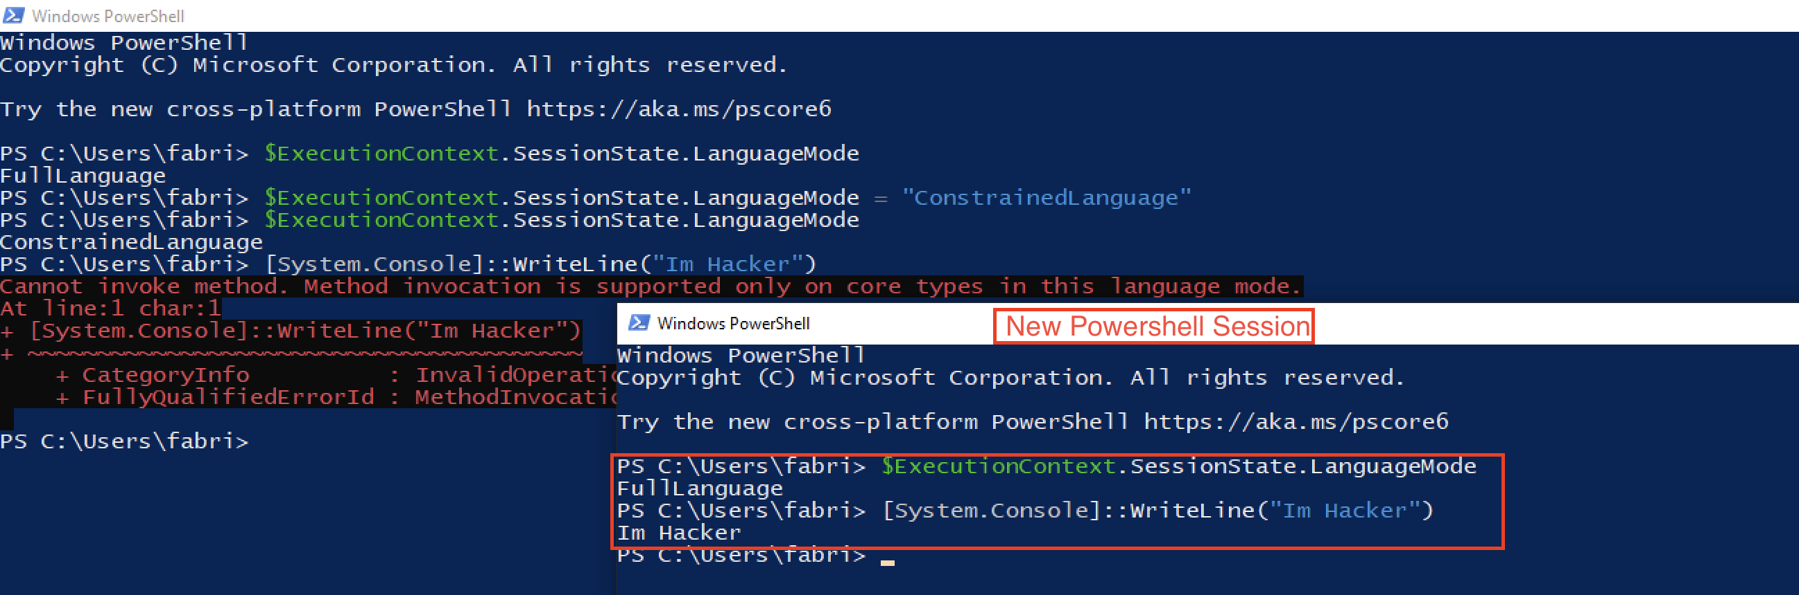
Bypass Constrained Language - For dummies

Slide 11
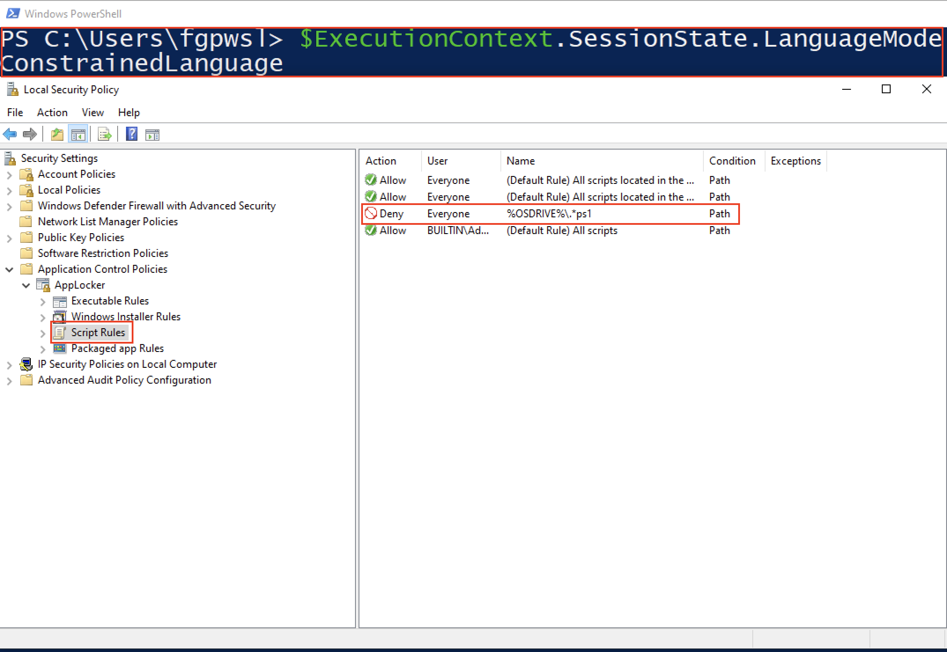
Enabling Constrained Language – For Hackers level I
Enable Constrained Language thought AppLocker

Slide 12
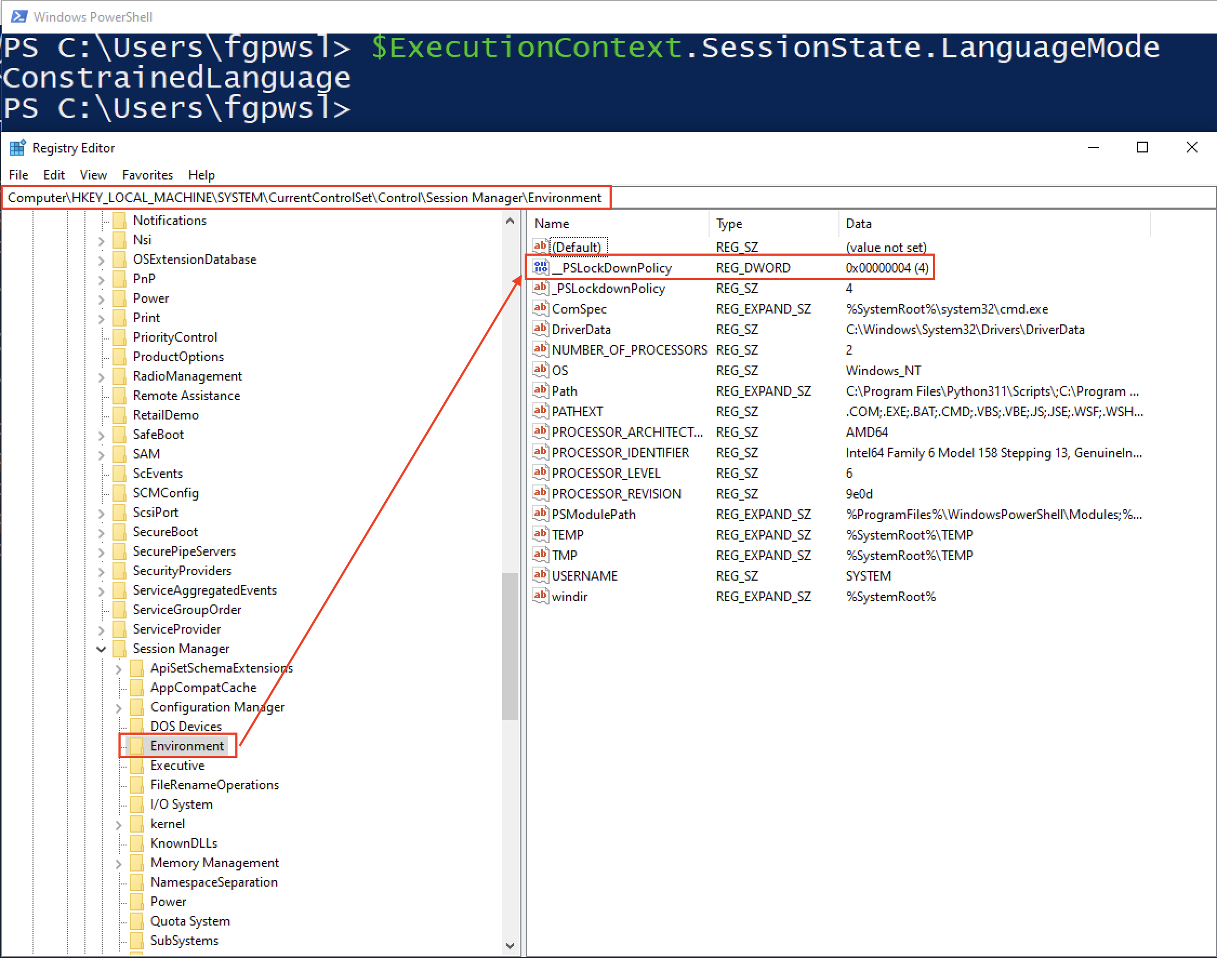
Enabling Constrained Language – For Hackers level II
Enable Constrained Language thought Regedit

Slide 13
Concept PowerShell RunSpace
There are two main types of Runspaces in PowerShell:
Local Runspaces: This type of runspace is created within the same process as the PowerShell session itself. Local runspace is used for normal interactive PowerShell commands and scripts.
Remote Runspaces: This type of runspace is created on a remote computer and can be used to execute PowerShell commands and scripts on that remote computer. Remote runspace is commonly used when managing multiple computers at once or for running scripts on remote machines.

Slide 14
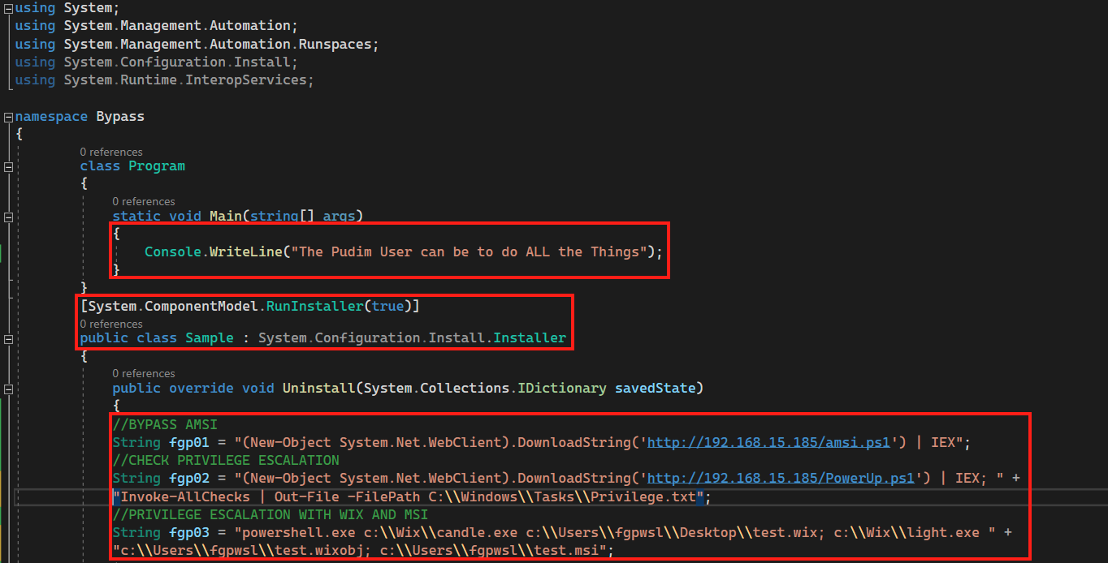
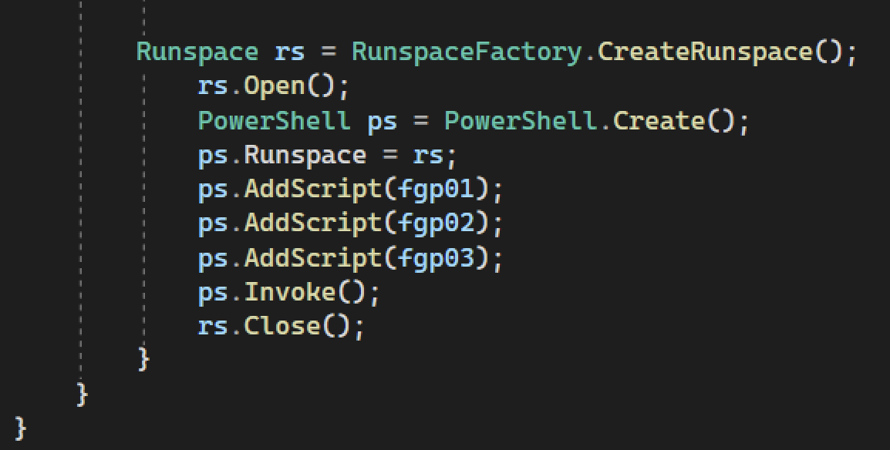
Bypass Constrained Language With RunSpace

Slide 15
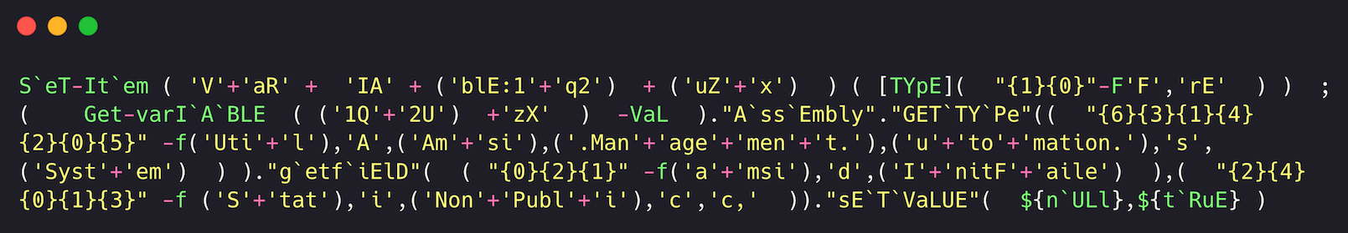

Plus – Script to Bypass AMSI

Slide 16
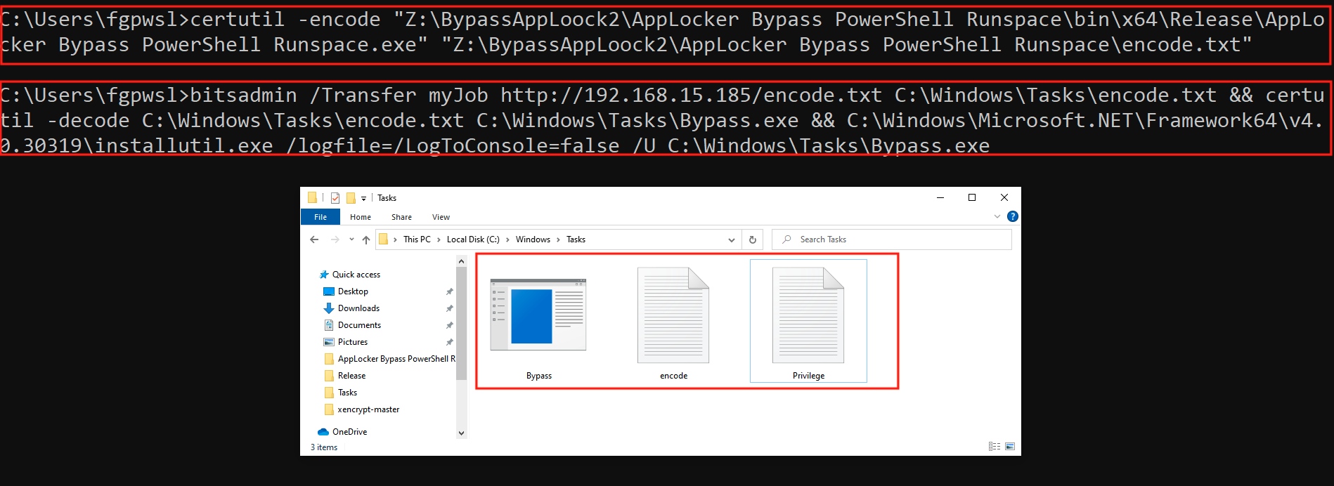
PoC – Recon through the Constrained Language
The Installer tool is a command-line utility that allows you to install and uninstall server resources by executing the installer components in specified assemblies. This tool works in conjunction with classes in the System.Configuration.Install namespace.

Slide 17

Privilege Escalation with AlwaysInstallElevated “New Approach”

Slide 18
What’s Privilege Escalation?
Privilege escalation means a user receives privileges they are not entitled to. These privileges can be used to delete files, view private information, or install unwanted programs such as viruses. It usually occurs when a system has a bug that allows security to be bypassed or, alternatively, has flawed design assumptions about how it will be used. Privilege escalation occurs in two forms.

Slide 19
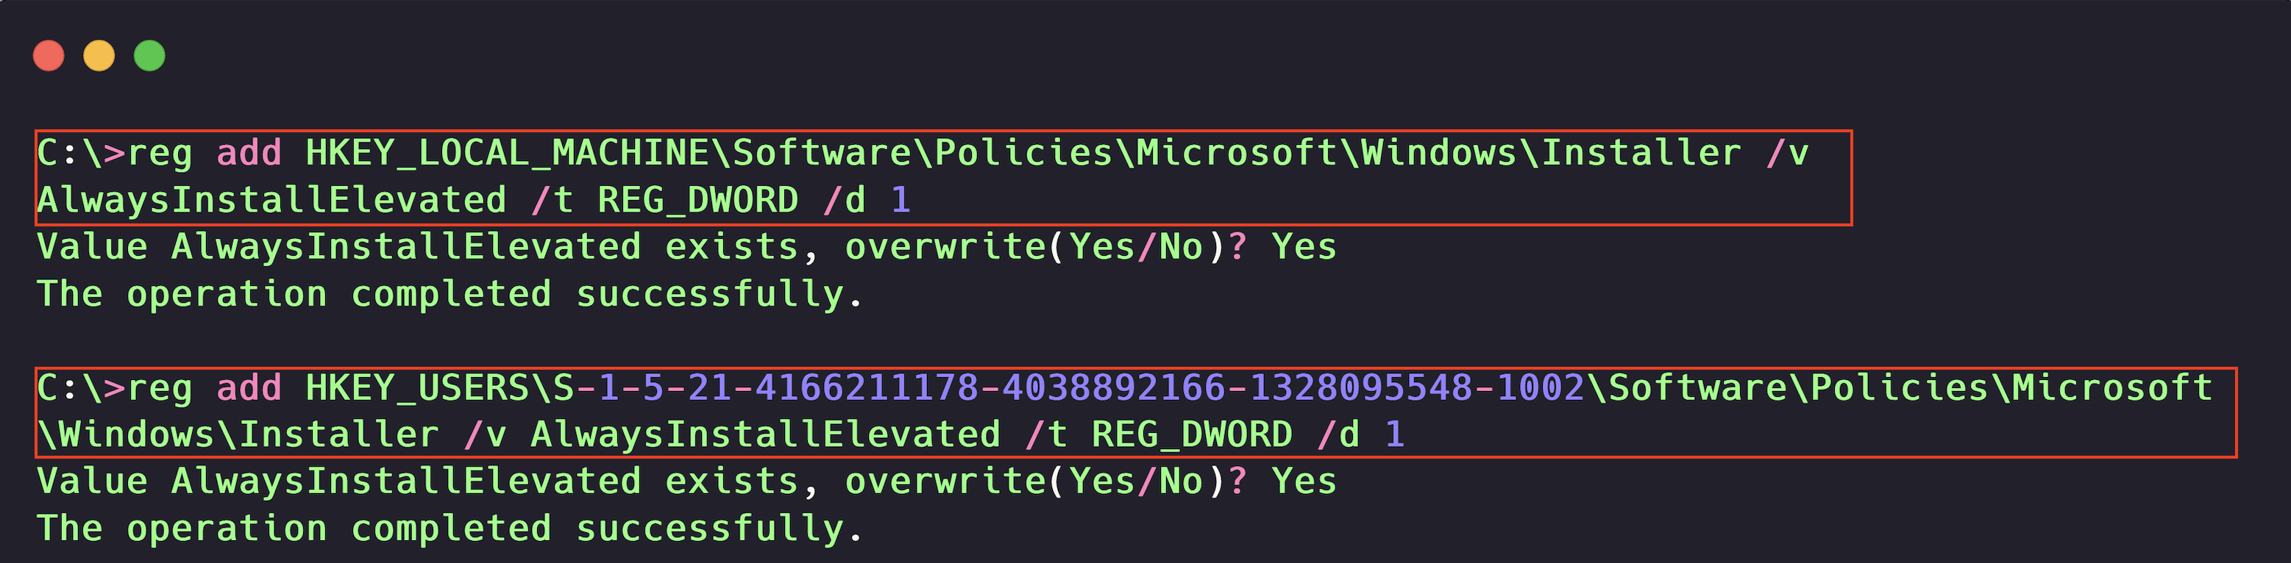
AlwaysInstallElevated
You can use the AlwaysInstallElevated policy to install a Windows Installer package with elevated (system) privileges.
**Warning:**
This option is equivalent to granting full administrative rights, which can pose a massive security risk. Microsoft strongly discourages the use of this setting.
HKEY_CURRENT_USER\Software\Policies\Microsoft\Windows\Installer
HKEY_LOCAL_MACHINE\Software\Policies\Microsoft\Windows\Installer

Slide 20
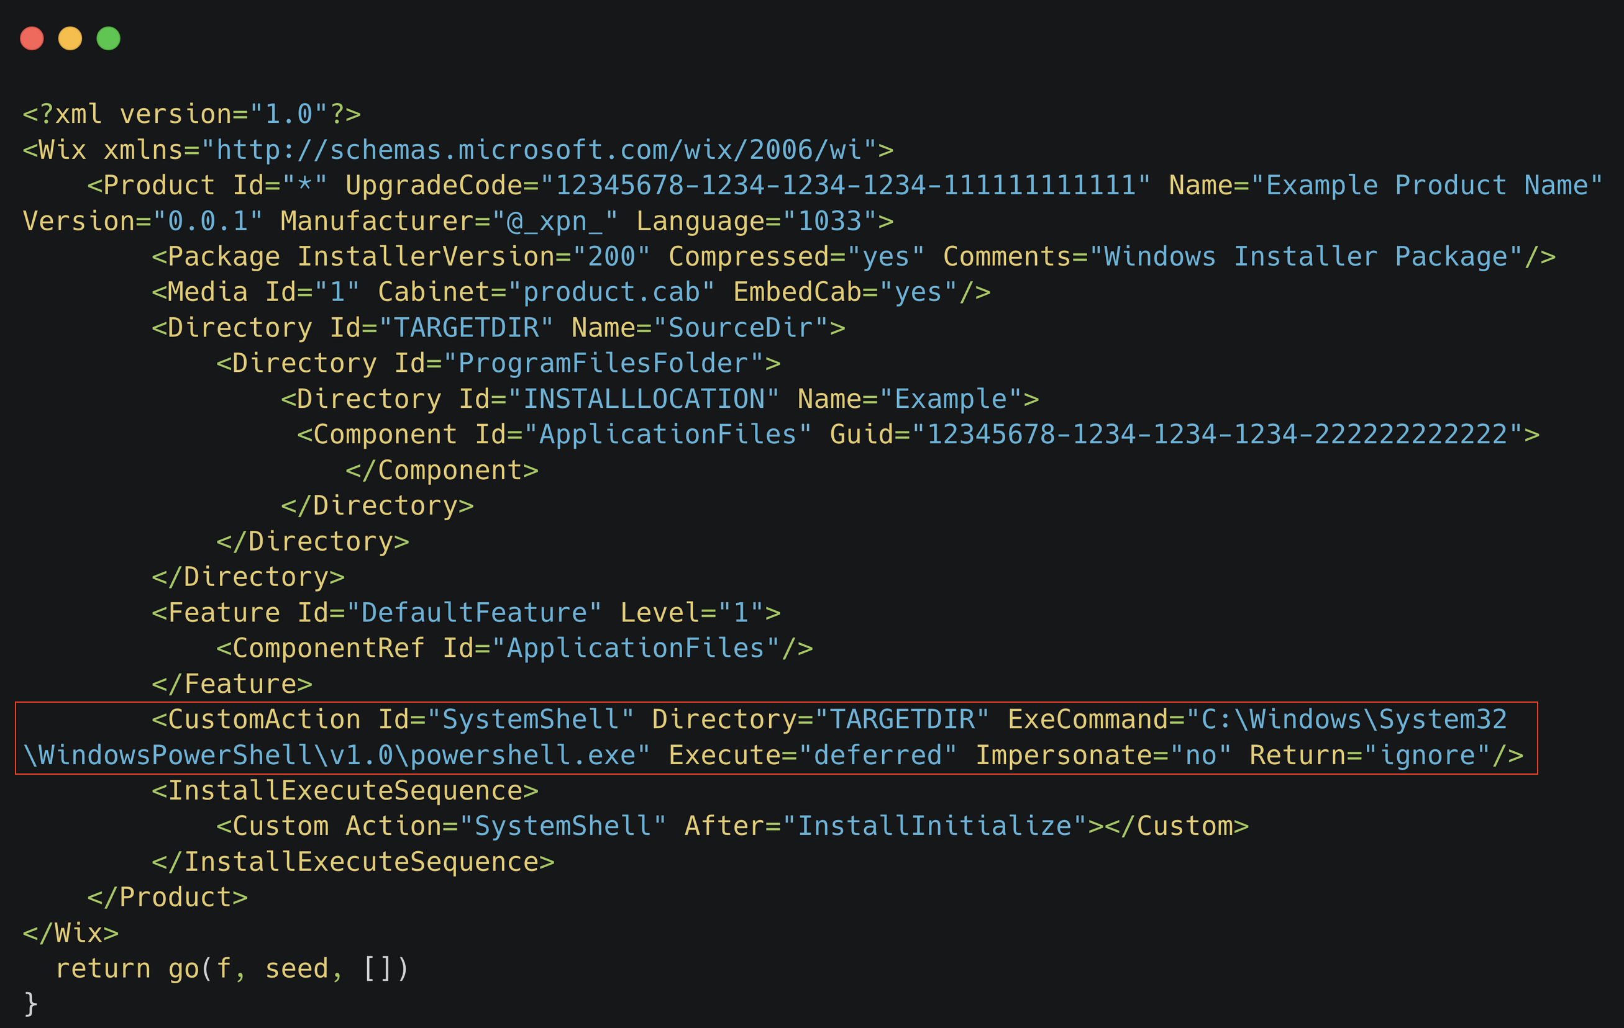
AlwaysInstallElevated – Wix File Example

Slide 21
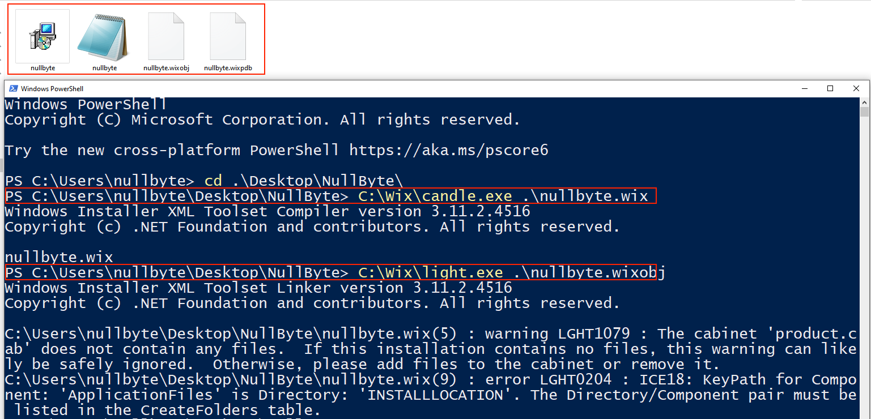
AlwaysInstallElevated – Wix File Example

Slide 22

Persistence with Windows Event Log?

Slide 23
Windows Event Viewer
The collection of logs in a folder within Event Viewer called Application and Services Logs that contains logs of individual applications and hardware-based events. Windows PowerShell logs would be found in this collection.
The following fields are some of the most filtered fields for log analysis:
Log/Key <– e.g., Application
Source <– e.g., Outlook
Date/Time
EventID
Task Category <– Application defined
Level
Computer
Event Data <– Message and Binary Data
Important
To write to the Application and Services Logs, you typically need administrative privileges.
If you try to write to these logs without administrative privileges, you may receive an "access denied" error.

Slide 24
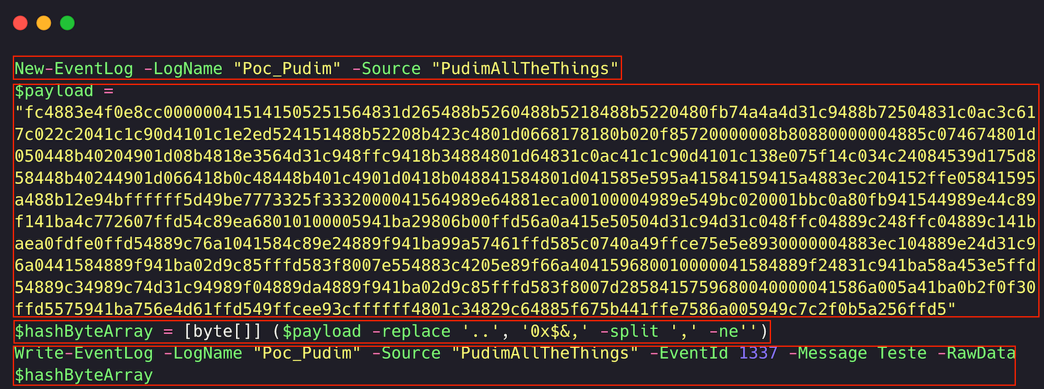
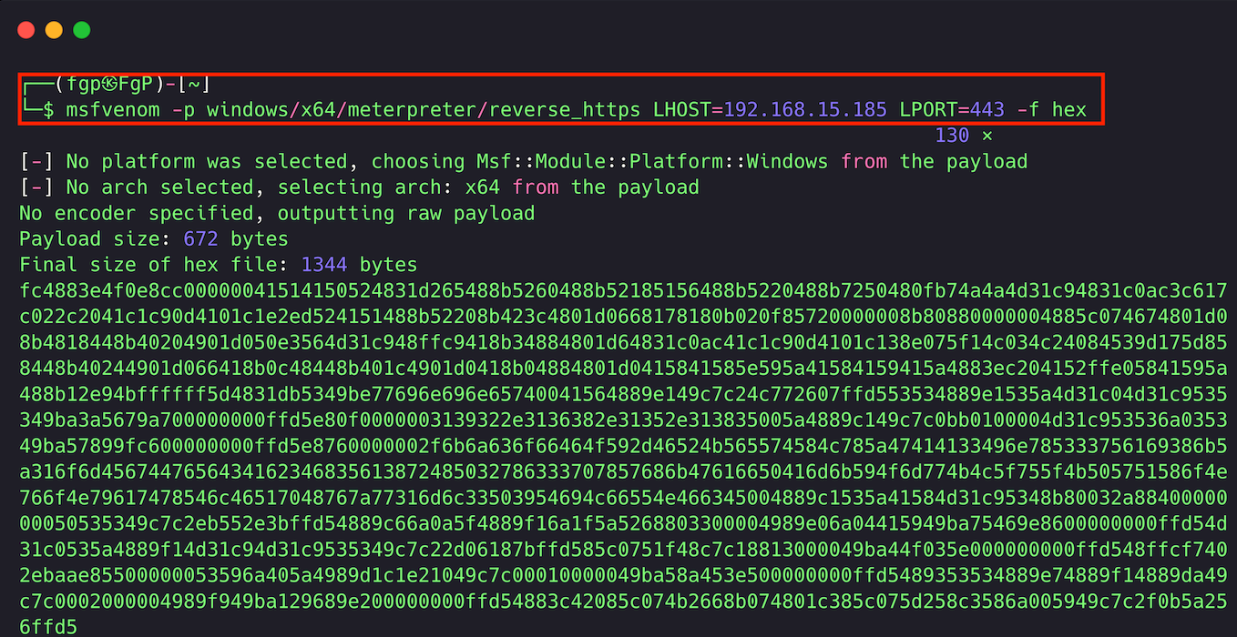
Create the malicious event log

Slide 25
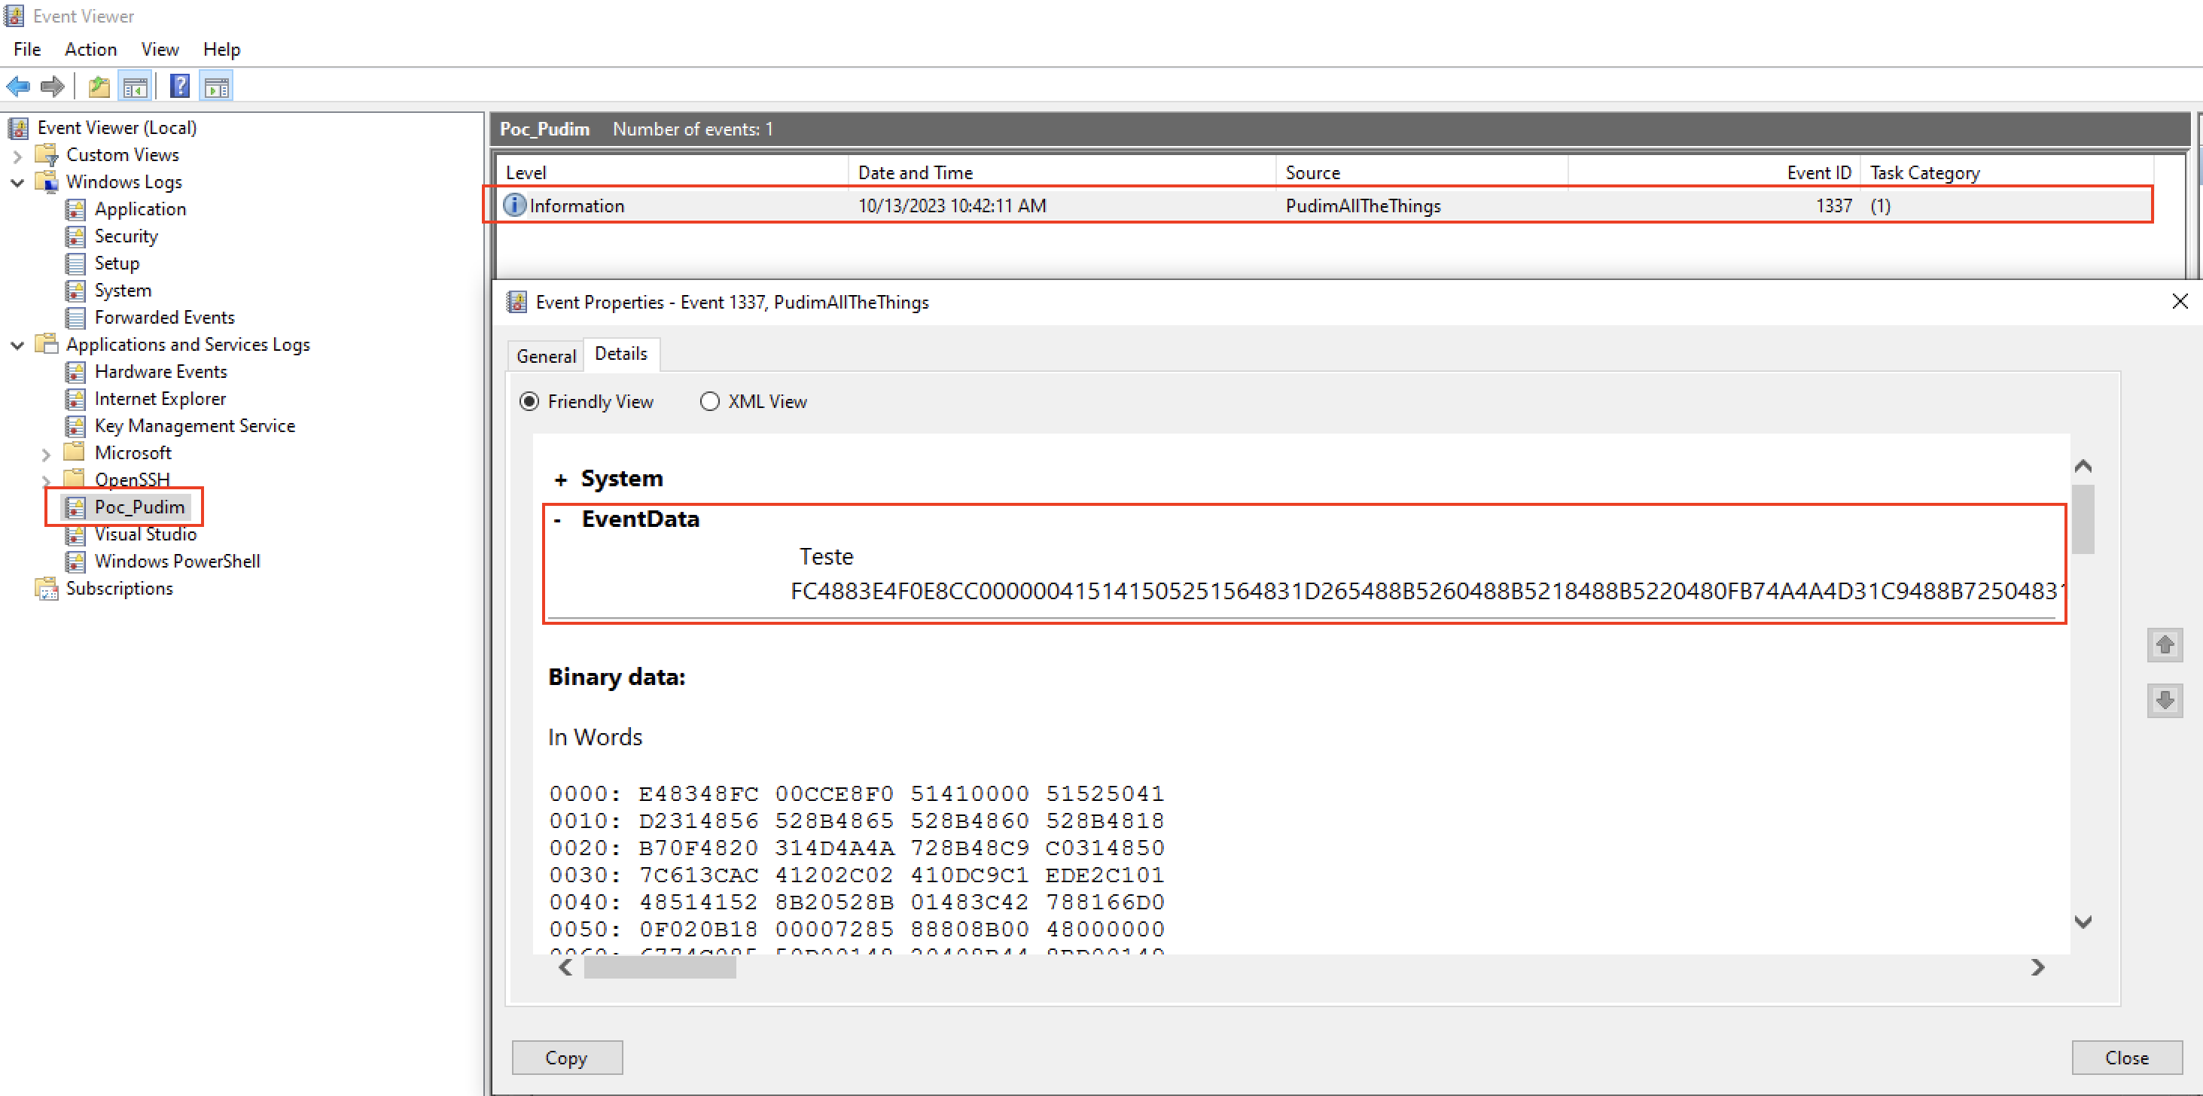
Windows Event Viewer
Notes:
The Windows Event Log is a feature in the Microsoft Windows operating system that provides a centralized repository for application, security, and system events.
The Event Log records events that occur on the system, including information about system crashes, errors, warnings, and informational messages.
The Event Log allows administrators to monitor and manage events that occur on the system, including identifying problems, debugging software, and tracking security incidents. The Event Log provides a searchable and filterable interface for reviewing events and can be used to generate alerts and notifications based on specific events.
The Windows Event Log service runs in the background and continuously writes events to the log files. The Event Log is essential for system administrators to diagnose and resolve issues on the system.

Slide 26
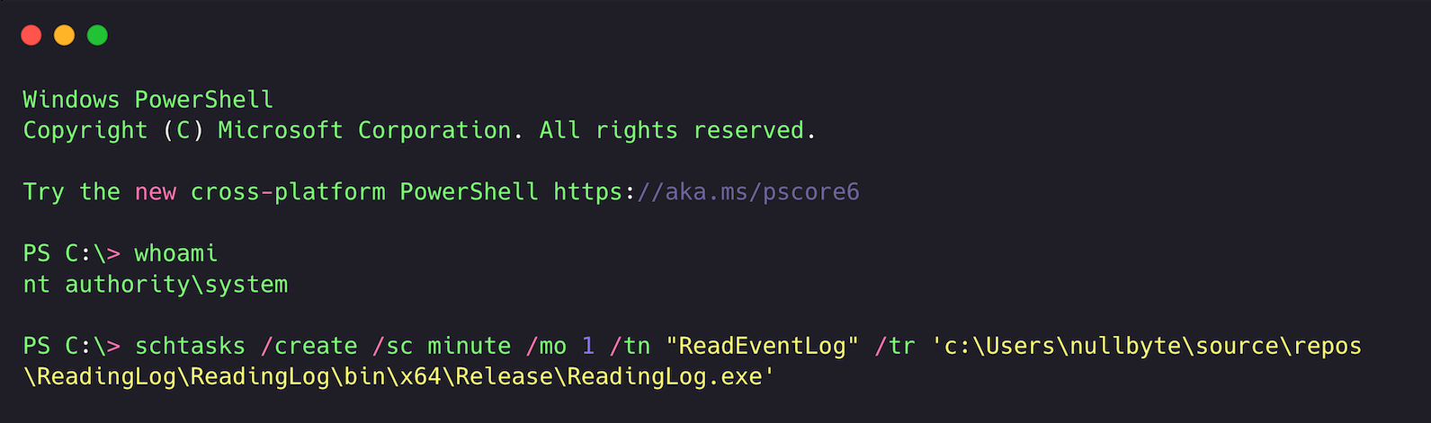
Schedule task and Persistence
Notes:
The Windows Event Log is a feature in the Microsoft Windows operating system that provides a centralized repository for application, security, and system events.
The Event Log records events that occur on the system, including information about system crashes, errors, warnings, and informational messages.
The Event Log allows administrators to monitor and manage events that occur on the system, including identifying problems, debugging software, and tracking security incidents. The Event Log provides a searchable and filterable interface for reviewing events and can be used to generate alerts and notifications based on specific events.
The Windows Event Log service runs in the background and continuously writes events to the log files. The Event Log is essential for system administrators to diagnose and resolve issues on the system.

Slide 27
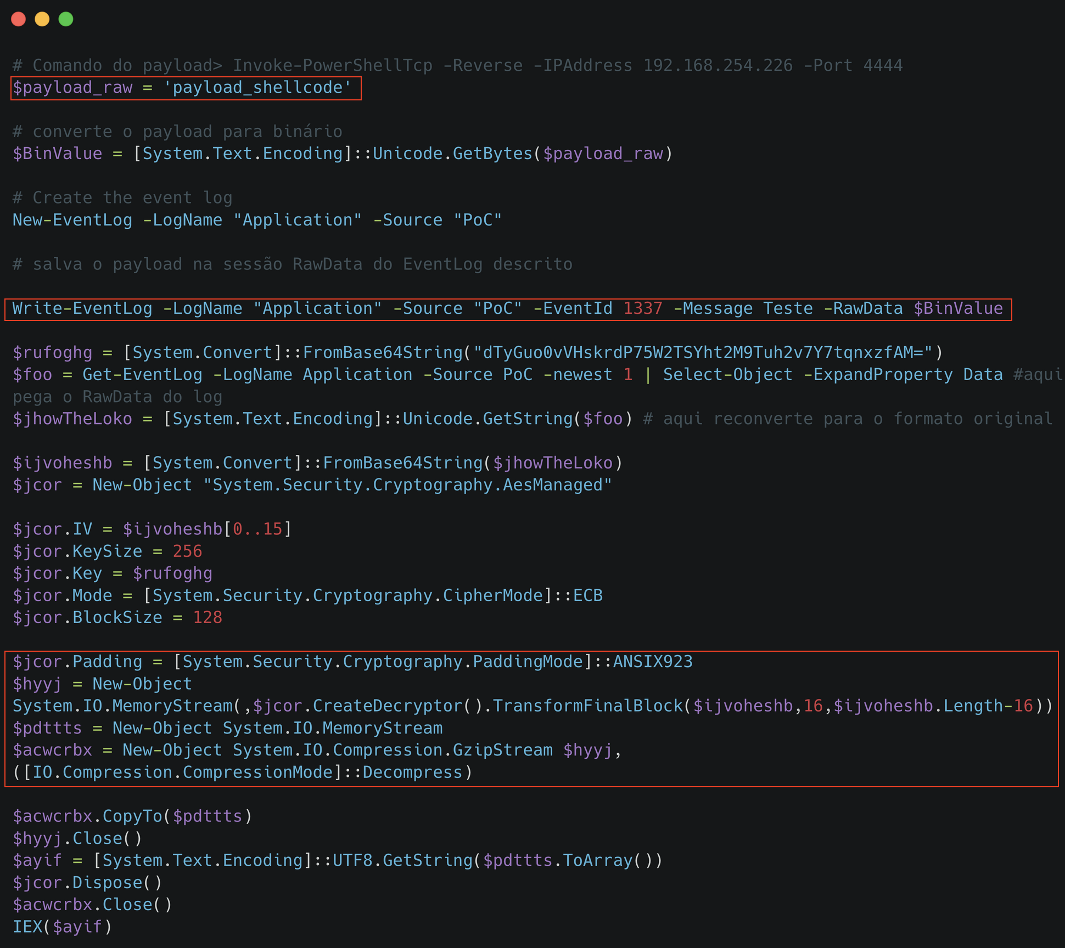
Windows Event Log – PoC PowerShell and AES256

Slide 28
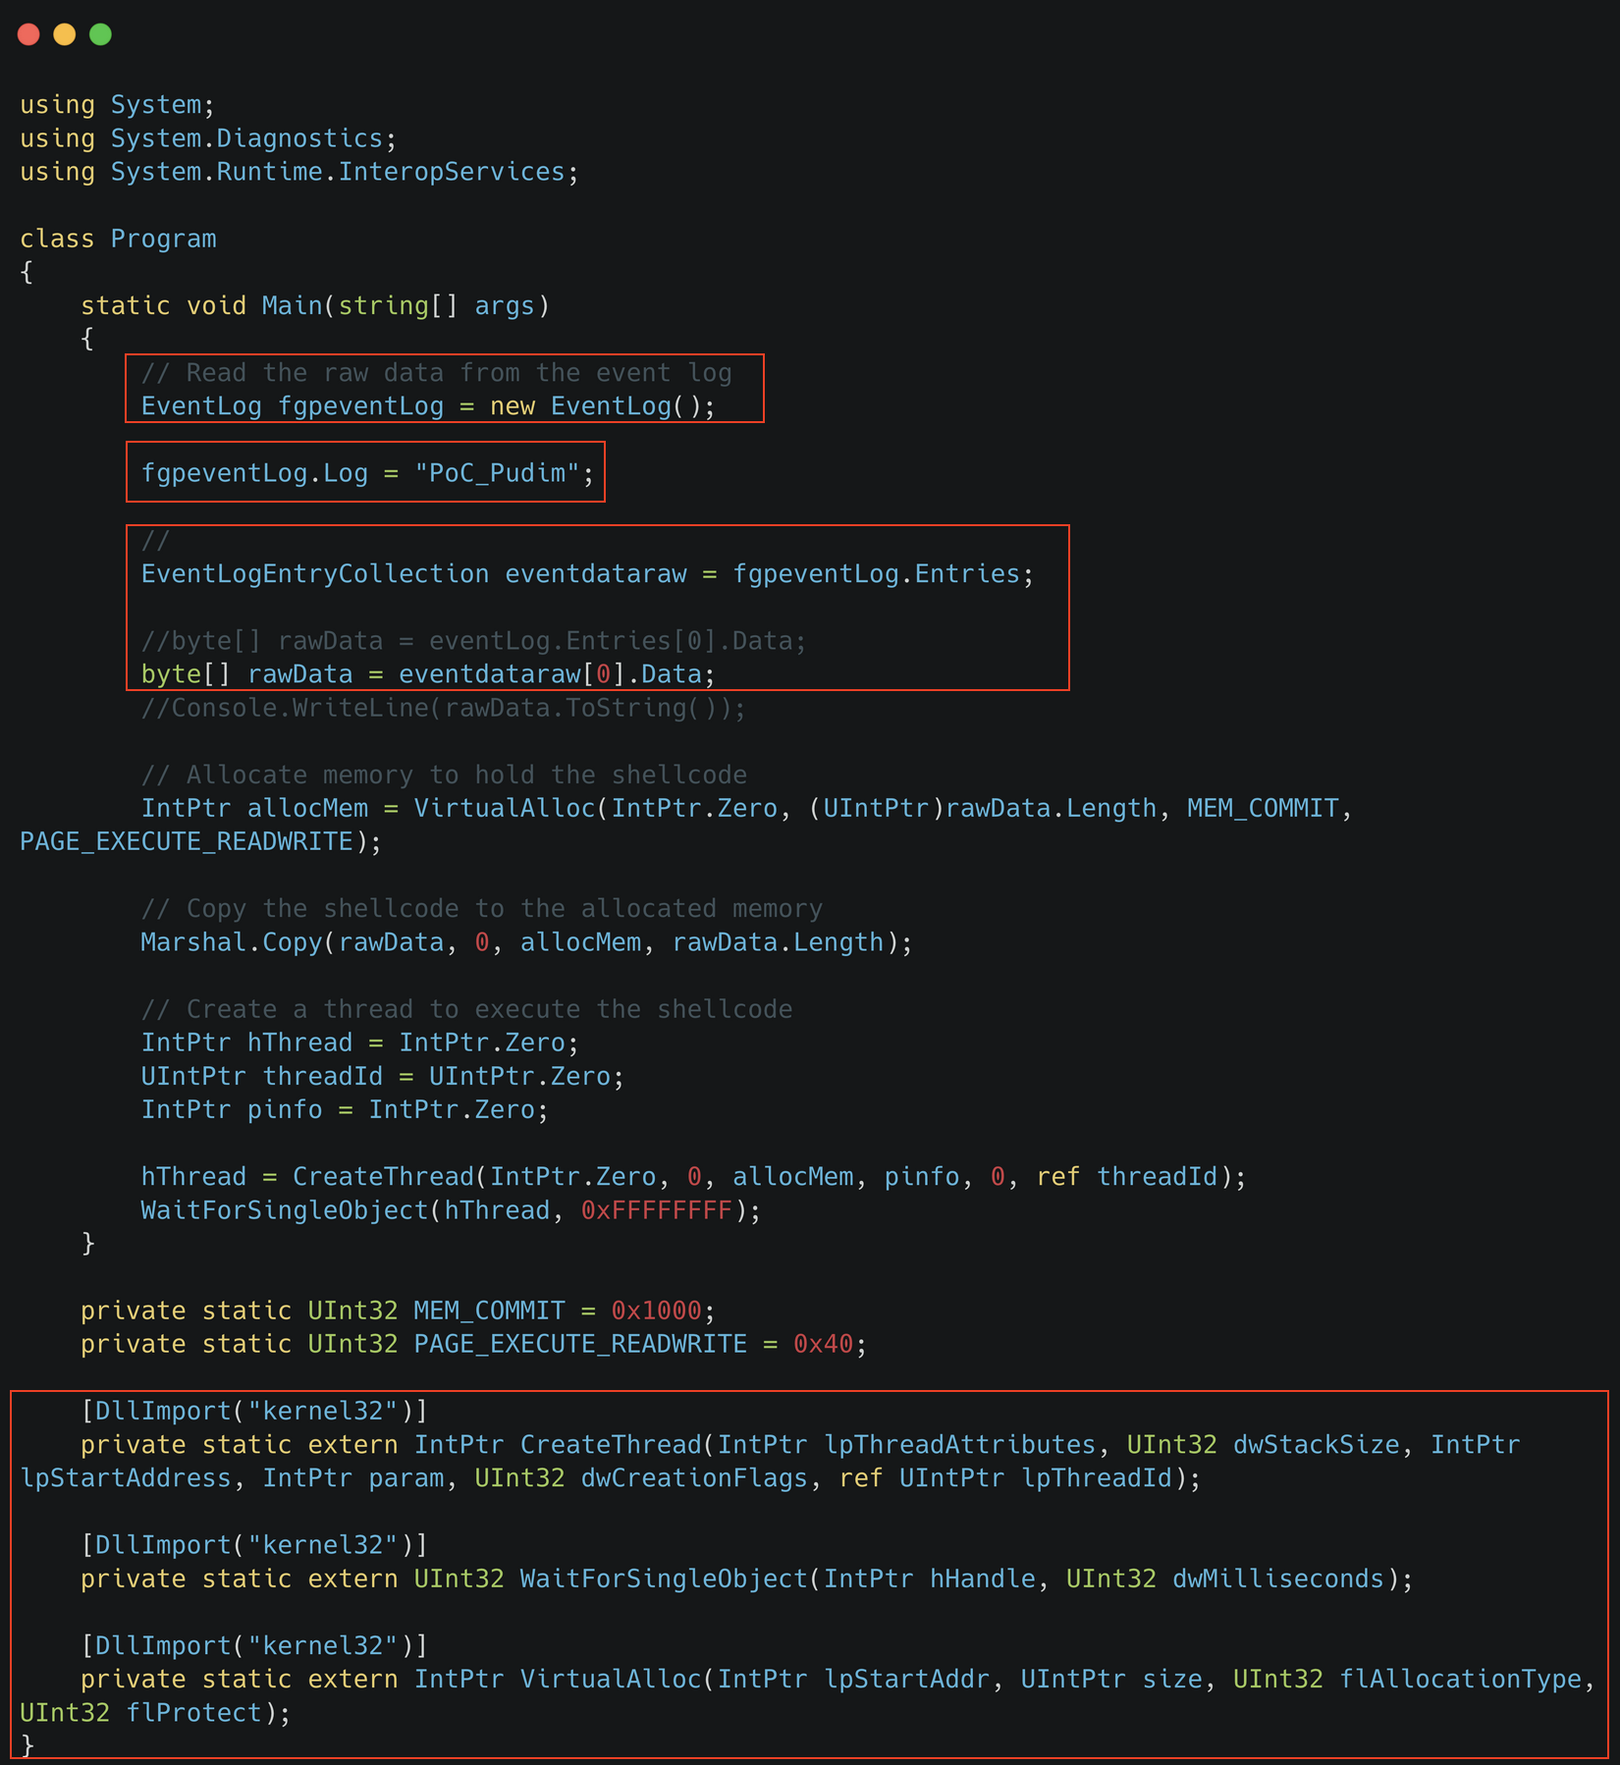
Windows Event Log – PoC C# Code

Slide 29

PoC – All the Things

Slide 30
Thank you
And
Questions

